Slide 1
R.Lusser-Lusser’s Law
J.Bernoulli-law of large numbers (LLN)
P.Chebyshev-Chebyshev inequality
A.Kolmogorov-Kolmogorov axioms

Slide 2
故障数据的统计分析——产品组成零部件故障数百分比
Subsystem | Parts | Failure percentage%
Electrical equipment | Integrated circuit | 77.5
 | Cord | 12.5
 | Joint | 10.0
Flippers | Others | 63.8
 | Fender | 21.8
 | Hydraulic cylinder | 14.4
Hydraulic system | Power equipment | 65.5
 | Hydraulic piping | 20.2
 | Accessories | 14.3
Scalable system
 | Position limit switch | 90.3
 | Cylinder | 9.7

Slide 3
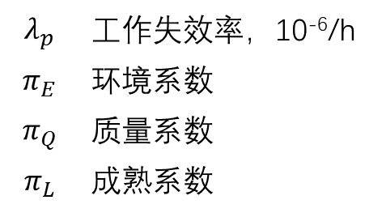
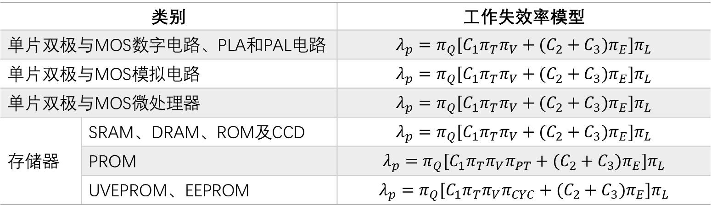
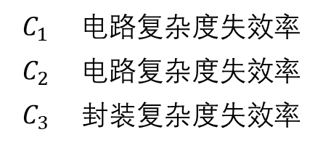
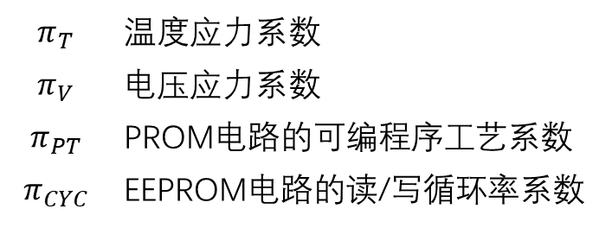
Type |  | Failure model
Monolithic bipolar and MOS digital circuits, PLA and PAL circuits
Monolithic bipolar and MOS analog circuits
Monolithic bipolar and microprocessor
Memory | SRAM, DRAM, ROM, CCD
 | PROM
 | UVEPROM, EEPROM
 | Failure rate，10⁻⁶/h
 | Environmental coefficient
 | Quality coefficient
 | Maturity coefficient
 | Temperature stress coefficient
 | Voltage stress coefficient
 | Programmable process coefficient of PROM circuits
 | Read/Write circulation rate coefficient of EEPROM circuits
 | Circuit complexity coefficient
 | Circuit complexity coefficient
 | Package complexity coefficient

Slide 4
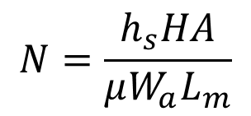
1
t_{c}
The oxide layer thickness of chip
Gate oxide breakdown E model
Design parameter
V_{g}
Gate voltage of oxide layer
C
Breakdown factor of E model
Material parameter
A
Field acceleration factor of E model
E_{a}
Activation energy of breakdown
Life span
Load parameter
T_{g}
Work temperature of chip
2
Threshold parameter
h_{s}
Maximum allowable of abrasion
Archard abrasion life model
H
Material hardness
$$N=\frac{h_{s}HA}{μW_{a}L_{m}}$$
Material parameter
μ
Coefficient of kinetic fiction
A
Contact area of wear surface
Abrasion time
Load parameter
W_{a}
Positive pressure of contact surface

Slide 5

General type of performance degradation model
P | Performance parameter vector | x | Input parameter vector
t | time | P_{th} | Performance parameter threshold
Shock and vibration stress model（first order vibration）
Input parameter
parameter | Parameter meaning | dimension
 | Parts length | mm
 | Package relevant parameter | none
 | Thickness or altitude of PCB | mm
 | The length of PCB edge which parallel to the long side of the component | mm
 | Inherent frequency | Hz
 | Relative curvature of the circuit board | none
Time irrelevance
,failure happened
Z_{allow} | Ideal maximum displacement
Z_{max} | Practical maximum displacement

Slide 6
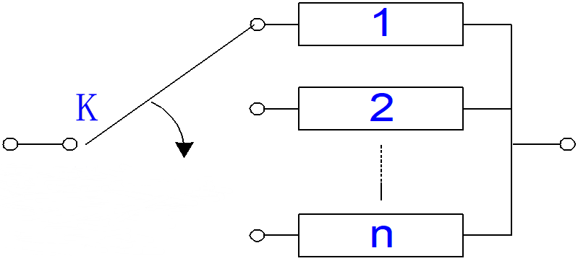
Types of reliability models
Reliability framework of cascade system
Failure monitoring and switch equipment
Reliability framework of parallel system
Reliability framework of non-working reserve system
Reliability framework of r/n(G) system

Slide 7
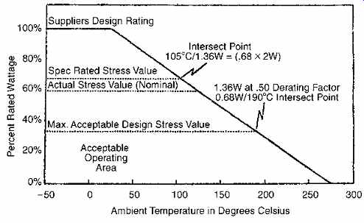
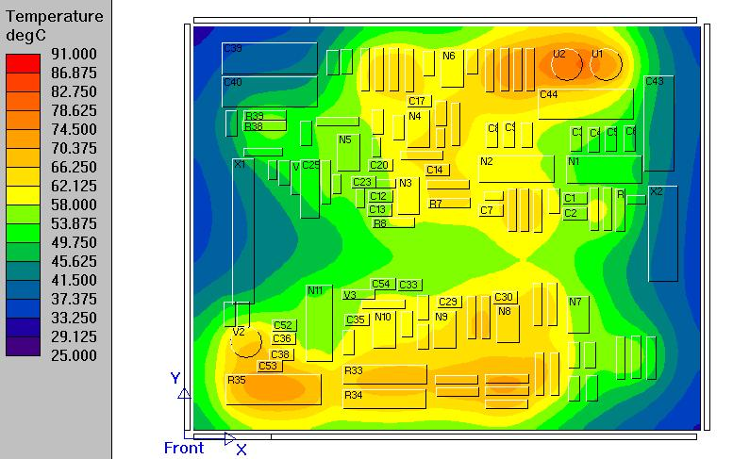
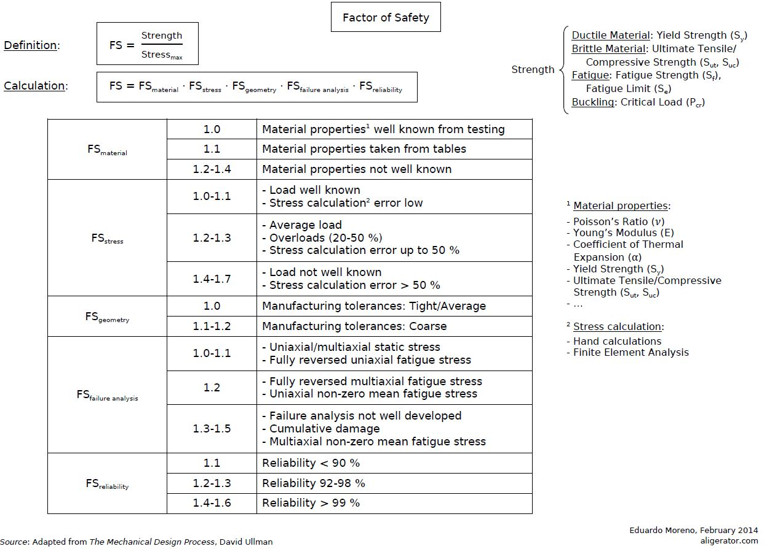
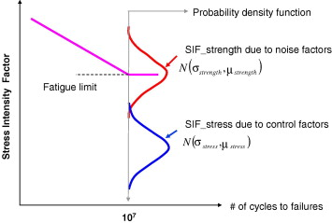
Derating design
Thermal design
Safety factor design
Stress-Intensity design

Slide 8


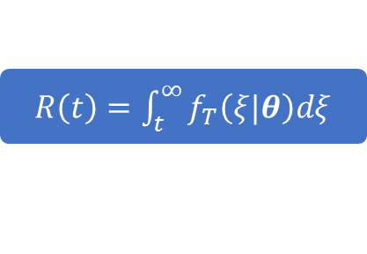
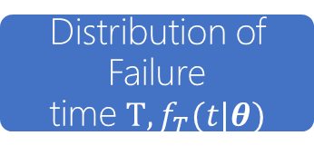




$R\left(t\right)=\int_{t}^{∞}{f_{T}\left(ξ|θ\right)dξ}$
Distribution of Failure time$T, f_{T}(t|θ)$
density
$$R_{m}(t)$$
------ prior D
—— posterior D
+
Prior distributon of $θ, p(θ)$
$$θ_{i}$$
$$t$$
+
Regard the posterior mid-value reliability $R_{m}\left(t\right)$ as
Reliability index
$$posterior distribution$$
$$of θ, p(θ|t)$$
A small amount of products failure time data 𝒕

Slide 9
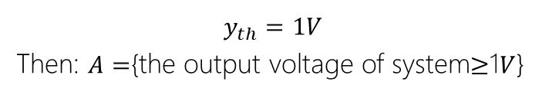
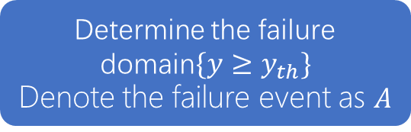
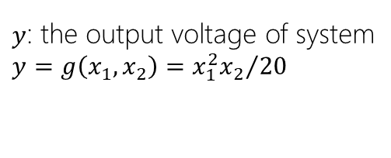
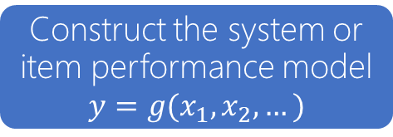
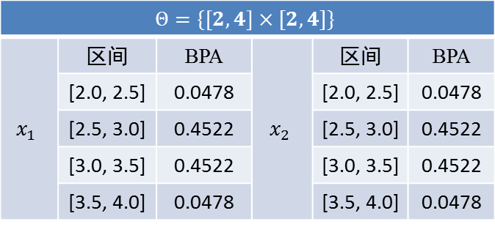

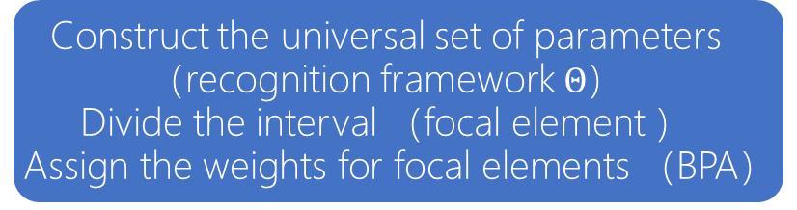

Construct the system or item performance model
$$y=g(x_{1},x_{2},…)$$
$y$: the output voltage of system
$y=g\left(x_{1},x_{2}\right)={x_{1}^{2}x_{2}}/{20}$
Determine the failure domain$\{y≥y_{th}\}$
Denote the failure event as $A$
$$y_{th}=1V$$
Then: $A=${the output voltage of system$≥$1$V$}
 | interval | BPA |  | interval | BPA
 | [2.0, 2.5] | 0.0478 |  | [2.0, 2.5] | 0.0478
 | [2.5, 3.0] | 0.4522 |  | [2.5, 3.0] | 0.4522
 | [3.0, 3.5] | 0.4522 |  | [3.0, 3.5] | 0.4522
 | [3.5, 4.0] | 0.0478 |  | [3.5, 4.0] | 0.0478
Construct the universal set of parameters（recognition framework $Θ$）
Divide the interval （focal element ）
Assign the weights for focal elements （BPA）
Failure probability interval$\left[Bel\left(B\right), Pl(B)\right]$
$$0.5≤P(A)≤0.976$$

Slide 10

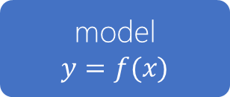



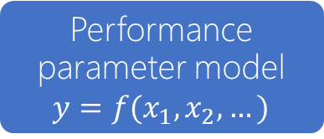
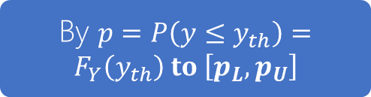


input parametes interval $x_{L}≤x≤x_{U}$
model
$$y=f(x)$$
output failure probability interval $y_{L}≤y≤y_{U}$
interval algorithm or optimization algorithm
the box of probability, $y$
Performance parameter model $y=f(x_{1},x_{2},…)$
$$\left.F_{Y}(y\right)$$
+
By $p=P\left(y≤y_{th}\right)=F_{Y}\left(y_{th}\right) to \left[p_{L},p_{U}\right]$
Distribution feature parameter interval of expert-based，$\left[μ_{iL},μ_{iU}\right], \left[σ_{iL},σ_{iU}\right],…$
$$y$$
method：Cartesian product, Optimization algorithm

Slide 11







The three principles of reliability science
$$p$$
$$p$$
$$φ(x)$$
$$m$$
$$p_{th}$$
$$\overset{⃑}{T}$$
$$x$$
Margin reliable
Eternal degradation
Uncertainty
The performance margin of object determine the reliability
Object properties undergo the irreversible degradation with time goes by
The process of degradation and performance of object is unknown

Slide 12
The four principles of reliability measurement
normalization
Slow-decay
Controllable
Integration
The sum of reliability and unreliability should be 1.
From part to whole, the reliability should not decay rapidly.
The factors which influence the reliability should be controllable. And Adjusting these factors, the reliability can be changed expectantly.
The measurement can reflect the inherent uncertainty, cognitive uncertainty, and the hybridization of them.

Slide 13



Probability measure
Chance measure
Uncertainty of model
Random system
Uncertainty random system
Uncertainty of parameter
Performance margin
Uncertain system
Belief reliability
Big data
Uncertainty measure
Chance measure
Sparse data
Failure time
Mathematical foundation
Uncertainty theory
Probability
Chance theory

